Slide 1
Miscellaneous items
Lab
Assignment 1
functional decomposition
Testing
Submitting test cases

Slide 2
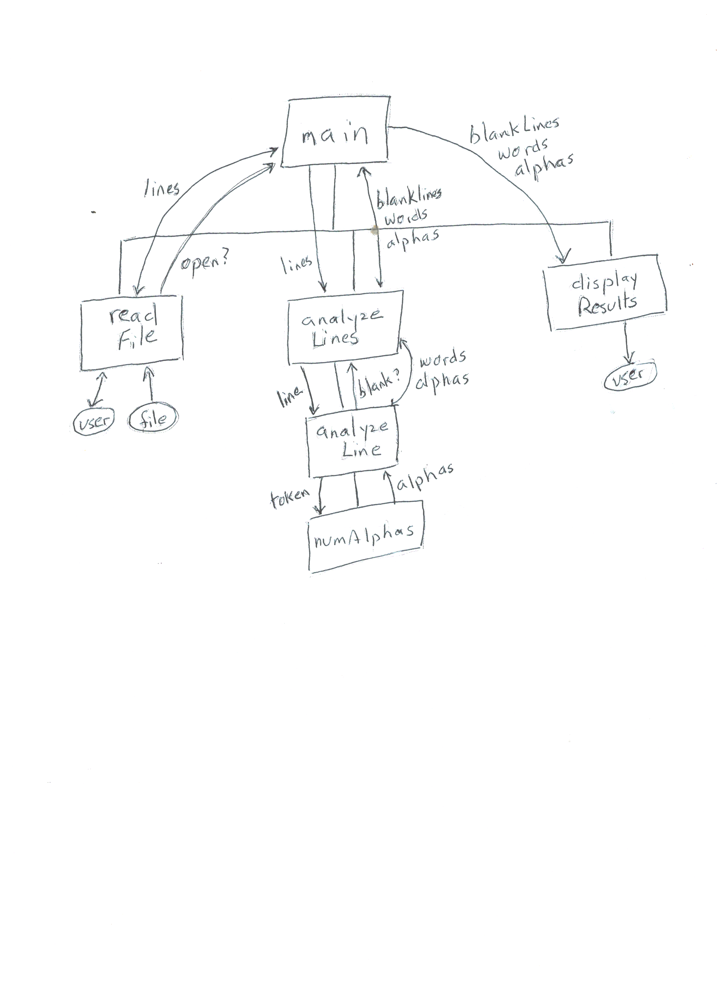

Slide 3
Arraylist.h
#ifndef array_List_
#define array_List_
#include "ListInterface.h“
const int CAPACITY = 10;
class ArrayList : public ListInterface {
public:
ArrayList();
bool isEmpty() const;
int getLength() const;
bool insert(int newPos, const ItemType & newEntry);
bool remove(int pos);
ItemType retrieve(int position) const;
bool append(const ItemType & newEntry);
private:
ItemType array[CAPACITY];
int size;
};
#endif

Slide 4
an ArrayList object
array
size
CAPACITY
10

Slide 5
Arraylist.cpp
Implement
Constructor
Isempty
Getlength
Implement
Append
implement
Retrieve
How to handle the precondition?
Implement
Insert
remove

Slide 6
Arraylist.cpp constructor, isEmpty, getlength
#include “ArrayList.h“
ArrayList::ArrayList(){
size = 0;
}
bool ArrayList::isEmpty() const{
return size == 0;
}
int ArrayList::getLength() const{
return size;
}

Slide 7
Implement append
bool append (const ItemType & newEntry);
//input: element to be added at end of the list
//output: if entry was appended return true; else return false

Slide 8
Arraylist.cpp append
bool ArrayList:: append(const ItemType & newEntry){
if(size >= CAPACITY)
return false;
array[size] = newEntry;
size++;
return true;
}

Slide 9
Arraylist.cpp retrieve
ItemType ArrayList::retrieve(int position){
return array[position - 1];
}
What is missing?

Slide 10
Dealing with preconditions
#include <cassert>
Contains the function assert
assert(some_Boolean_condition);
if condition is true
execution continues
If condition is false
program execution stops and error message displayed
Assert(position >= 1 and position <= getLength())
Caller of a method that has a precondition is responsible for meeting it

Slide 11
Arraylist.cpp retrieve – with assert
ItemType ArrayList:: retrieve(int position){
assert(position > 0 and position <= size);
return array[position - 1];
}

Slide 12
Insert and remove
Check to see if position for insertion or removal is valid
If yes
For insertion – shift items upward in array to make room for newitem
For deletion – shift items downward in array to fill in the gap
Increment or decrement size

Slide 13
Assignment 2
Assignment 1 was decomposed using functions
Assignment 2 will be decomposed using functions and classes
classes
Itemtopurchase
Linkedlist – inherits from listinterface (is-a)
Shoppingcart
Has-a linkedlist to hold items purchased
Program decomposed using functions
Manages contents of a shopping cart

Slide 14
ListInterface
ShoppingCart
is-a
has-a
has-a
program
LinkedList
has many
ItemToPurchase

Slide 15
Before thurday’s class
do zybook exercises
ch 12 (.1 through .7)
Note: list operations are value oriented, rather than position oriented
read assignment 2
write expected output from test1.txt
this will be collected in class

Slide 16
linkedlist.h
#ifndef linked_List_
#define linked_List_
#include "ListInterface.h“ //no need for CAPACITY
class LinkedList : public ListInterface {
public:
LinkedList();
bool isEmpty() const;
int getLength() const;
bool insert(int newPos, const ItemType & newEntry);
bool remove(int pos);
ItemType retrieve(int position) const;
bool append(const ItemType & newEntry);
private:
};
#endif

Slide 17
Assignment 2
Questions?
Expected output from test2.txt?
Other tests?

Slide 18
A pencil 3 .25
A notebook 1 3.50
A snack_bar 1 1.25
A soda 1 1.50 1
A book 1 12.50 3
DA
D 5
DC
DC 2
DN
R 2
R 1
DA
DC
R 3
R 1
R 1
DA
DC
Item added
Item added
Item added
Item added at position 1
Item added at position 3
----------------------------------→
Snack_bar 1 @ $1.25
Total cost is $19.50
Pencil 3 @ $0.75
There are 5 items
Item at position 2 removed
Item at position 1 removed
--------------------------------→
Total cost is $17.25
Item at position 3 removed
Item at position 1 removed
Item at position 1 removed
There are no items
Total cost is $0
soda 1 @ $1.50
pencil 3 @ $0.25
book 1 @ $12.50
notebook 1 @ $3.50
snack_bar 1 @ $1.25
book 1 @ $12.50
notebook 1 @ $2.50
snack_bar 1 @ $1.25

Slide 19
Some other things to test
File is empty
Position specified in a command line is not valid
display error message and go on to next command
Retrieve has a precondition
Invalid command
Display error message and go on to next command

Slide 20
Zybook assignment
Before class on Tuesday Feb. 13 Do exercises in ch. 13

Slide 21
A linked list
head
element
element
element
a node
a node
a node
Elements are stored in nodes that are in non-contiguous memory locations
Nodes are linked together using pointers
A C++ programmer has to allocate and free space for nodes

Slide 22
pointers
Variables of type pointer have a value which is a memory address
Example: string* spointer ;
spointer is of type pointer to a string
String mystring = “CS240C”;
Spointer = &mystring;

Slide 23
Do not mistake the pointing finger for the moon
SPOINTER
MYSTRING
CS240C
cout >> SPOINTER >> endl;
cout >> MYSTRING >> endl;
cout >> *SPOINTER >> endl;

Slide 24
the new and delete operators
New allocates (at run time) memory space to store a value of some type and returns the address of that block of memory
Myclass* ptr = new myclass(-----);
Delete frees up the block of memory a pointer points to
Delete ptr;
Ptr = nullptr;
Nullptr is a c++ 11 keyword
Every new needs a delete
PTR
PTR

Slide 25
Elements of a linked list are stored in nodes
When an element is added to a linked list, a node is allocated using new
The element is stored in the node
The node has to be linked into the linked list
When an element is removed from a linked list, the node it occupied is freed using delete
Nodes of the linked list need to relinked

Slide 26
A node
class Node {
public:
ItemType data;
Node * next;
};
data next
Where should the Node class be defined?

Slide 27
head
56
93
78
What is the value of:
head
*head
head->data or (*head).data
head->next
head->next->data
head->next->next->next

Slide 28
head
56
93
78
What is the value of:
head the address of the node containing 56
*head the node containing 56
head->data or (*head).data 56
head->next the address of the node containing 93
head->next->data 93
head->next->next->next nullptr

Slide 29
Some questions
What data members are needed by a linked list implementation of a list?
What does an empty linked list look like?
Which methods need to use new?
Which methods need to use delete?

Slide 30
Some questions
What data members does a linked list implementation of listinterface need?
Node* head;
Int size;
What does an empty linked list look like?
Which methods need to use new?
Append
insert
Which methods need to use delete?
remove
head

Slide 31
Given the linked list shown write code to add the value 36 at the beginning
head
56
93
78
Allocate a node
Store 36 in it
Link this node into the existing linked list (at the beginning)

Slide 32
head
p
56
93
78
36
Node* p = new Node;
p->data = 36;
p->next = head;
head = p;

Slide 33
Given the linked list shown write code to display the data in the list
head
56
93
78
Use a temporary node pointer to traverse the list

Slide 34
Given the linked list shown write code to display the data in the list
head
56
93
78
Node* temp = head;
while (temp != nullptr) {
cout >> temp->data >> endl;
temp = temp->next;
}

Slide 35
Given the linked list shown write code to add the value 36 at the end
head
56
93
78
Allocate a node
Store 36 in it
Link this node into the existing linked list (at the end)

Slide 36
head
p
56
93
78
36
Node* p = new Node;
p->data = 36;
p->next = nullptr;
How can we link the new node to the end of the existing linked list?

Slide 37
Need a Pointer to the last node
Could traverse list stopping when temp->next == nullptr
temp→next = p;
Could add a data member that gives access to last node
Node* last;
Initialize to nullptr in constructor
Last->next = p;
What else is needed?
All mutator methods must update all data members if needed

